Slide 1
Fintech Solar Energy Prediction Project
Fares Djerourou

Slide 2
Contents of this Presentation
Data description, potential relationships and correlations between features.
Feature engineering, how the features were preprocessed to better fit the problem, which features were added to get better results.
Which features were ultimately selected to train our models based on their effectiveness.
The models used to predict the target variable, comparison between the models, and the one who was chosen in the end.
Hyperparameters tuning of the chosen model.
Which features were most relevant in the prediction process and how the final result compared to the given benchmark.
Plot of the predicted and actual value, potential improvements.

Slide 3
Data Description
Originally we had 15 features with different magnitudes and one categorical feature which was the Day/Night feature. We also have 15 different power plants and prior to transformation we had a single column for time which contains hourly data for each plant.
It is interesting to plot a heatmap to visualize the correlation between our features to check for potential collinearity, as well as plotting the correlation between the features and the target variable.

Slide 4
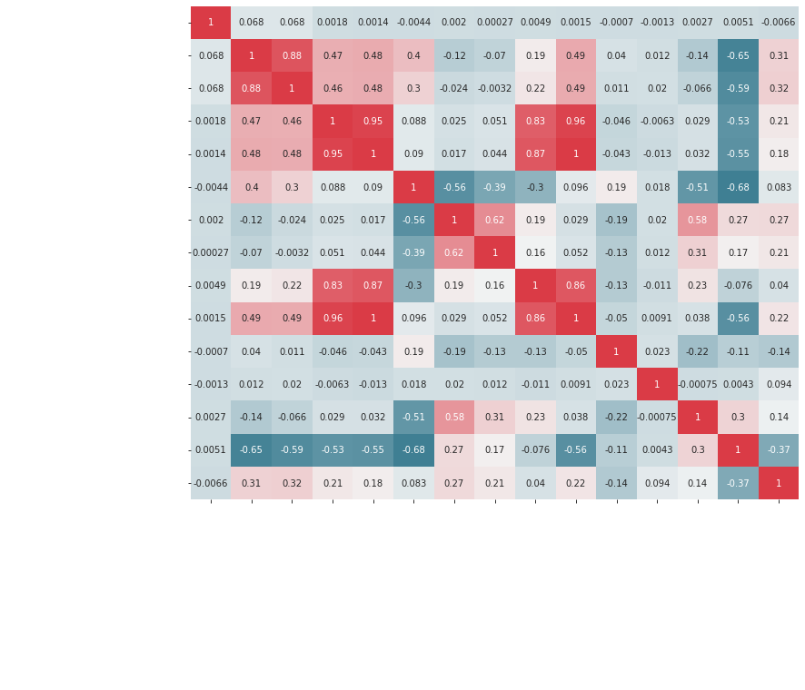
Correlation

Slide 5
Feature Engineering and Selection
At first all the features were used, except the benchmark feature obviously, dummy variables were used for the Day/Night feature and the UTC Time column was decomposed into year/month/day/hour columns.
The data was grouped by power plant to compute the lagged values of the energy production column by shifting it, it was done for an hour, one day, and one week.
The average value and the standard deviation over the 24 previous values for the same power plant were used as well.
For feature selection it was mainly done by trying different configurations of input features and seeing which features were most relevant. While taking into account which features were colinear and potentially redundant.

Slide 6
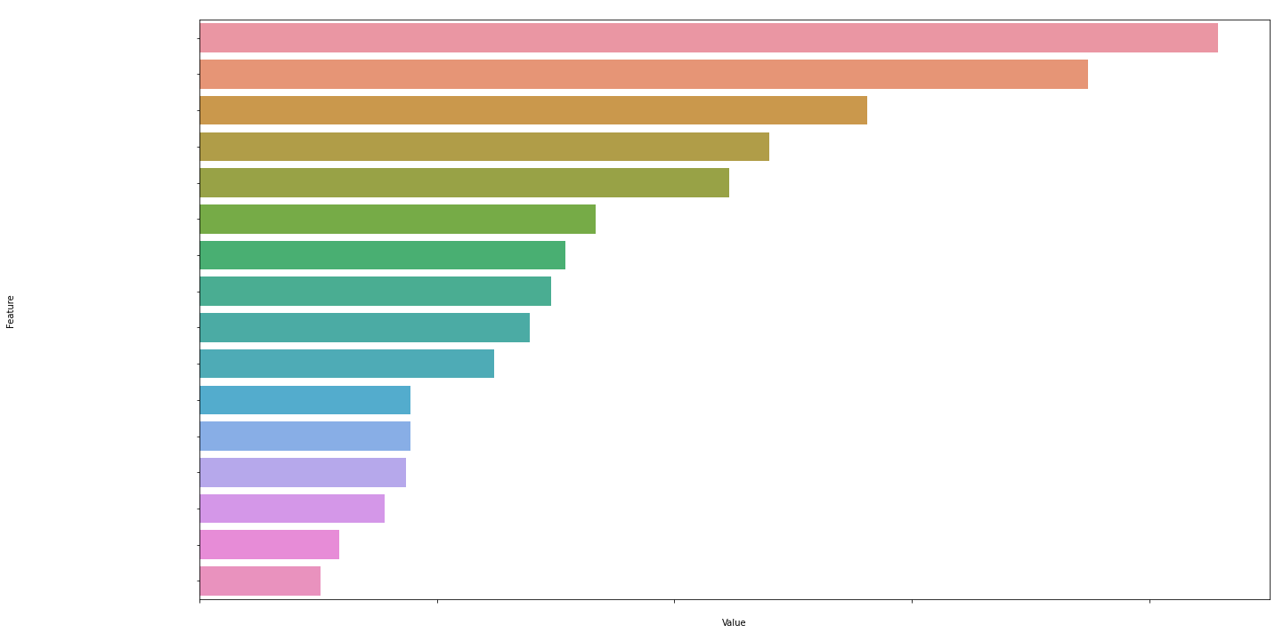
Feature Engineering and Selection

Slide 7
Models
XGBoost regressor
LGBM regressor
Linear regression
Feed forward neural network

Slide 8
Hyperparameters Tuning
Grid Search
Random Search
Bayesian optimization
Values in the search space
Learning rate
Number of trees
Maximum depth

Slide 9
Most Relevant Features
Time
Lagged values, especially for linear models/NNs
Humidity/Temperature/Visibility/Wind Speed/Precipitation Probability

Slide 10
Metrics on the Test Set
The root mean squared error for the first 1000 values of the test set with the prediction was around 0.0023, for the benchmark it was around 0.0055.
The R squared for the LGBM model was 0.95219 while it was 0.7864 for the benchmark.

Slide 11
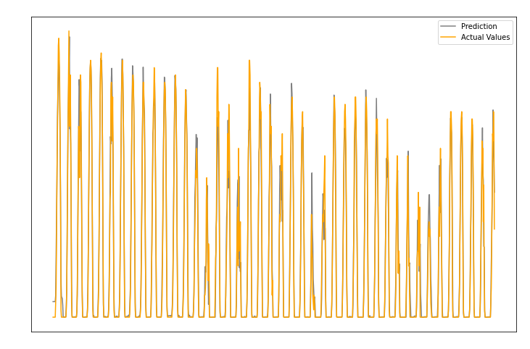
Plot for the 1000 First Values

Slide 12
THANK YOU

